Slide 1
Biological oxidation
Presented by:
Dr. Kalpana Jorasia
Assistant professor(VBC)

Slide 2
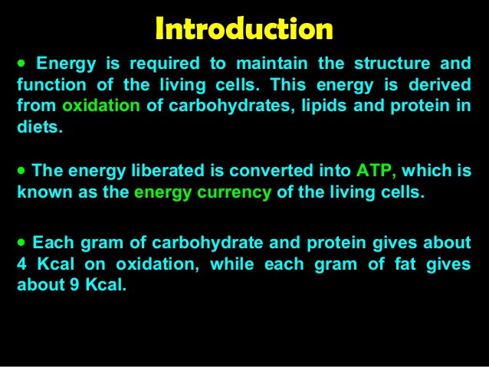

Slide 3
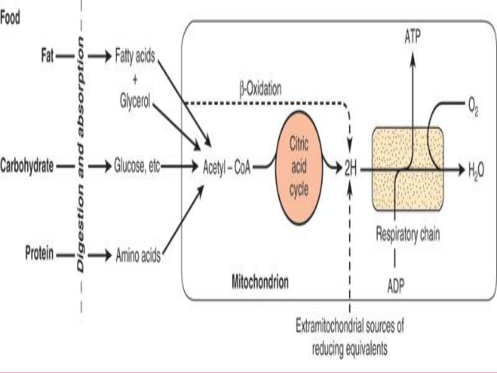

Slide 4
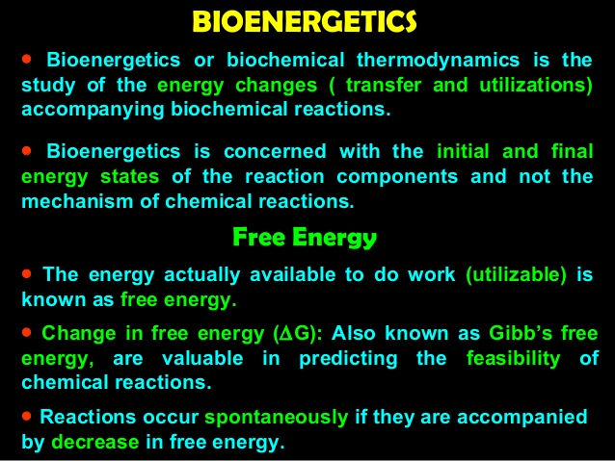

Slide 5
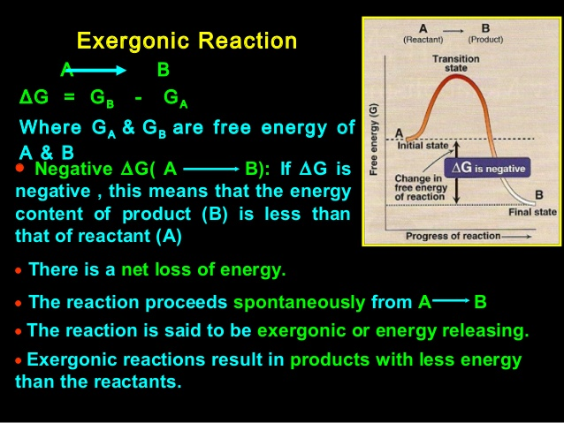

Slide 6
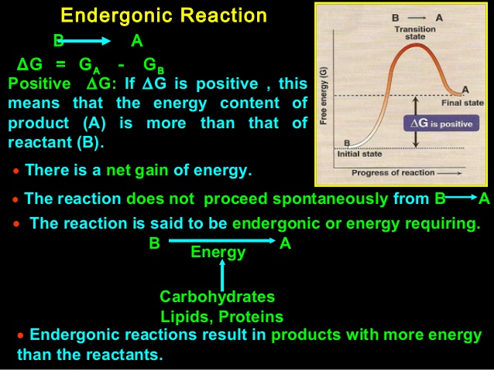

Slide 7
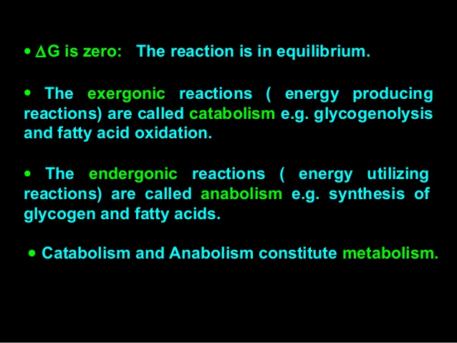

Slide 8
Exergonic /catabolism
ATP + H2O → ADP + Pi - Δ G = -7.3 cal/mol
Endergonic/anabolism
ADP + Pi → ATP + ΔG = +7.3 cal/mol
1. Enthalpy is a measure of change in heat content of the reactant, when compared to product, which is denoted as ΔH.
2. ΔS is the change in entropy. It is the term used to express the degree of randomness or disorder created during a reaction. The randomness is increased when a biomolecule is broken down to smaller molecules. For example: C₆H₁₂O₆ + 6O₂→ 6CO₂+ 6 H₂O
In this process there is an increase in randomness because 7 molecules produce 12 molecules. Whenever a chemical reaction proceeds, if there is an increase in the number of molecules, then, there is an increase in molecular disorder and thus an increase in entropy. This contributes to a – ΔG.

Slide 9
The relationship between change in free energy, enthalpy and entropy is expressed as
ΔG = ΔH - T ΔS
T is the absolute temperature.
The total of anabolic and catabolic processes is called as “Metabolism”.
The overall net change in metabolism is exergonic.
Standard free energy change (ΔGº): It indicates the free energy change when the reactants or products are at concentration of 1mol/l at pH 7.0

Slide 10
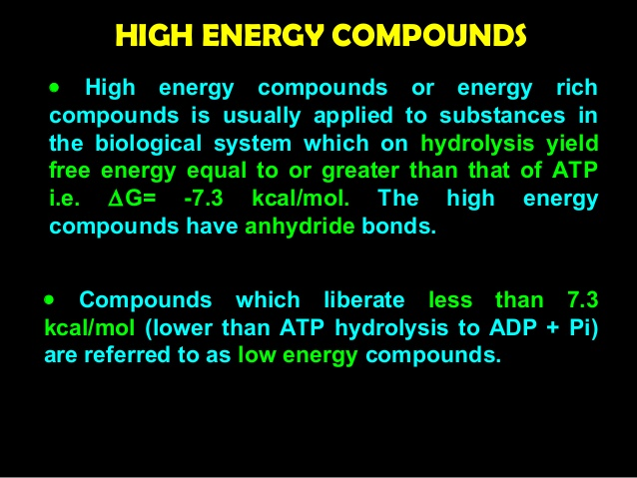

Slide 12
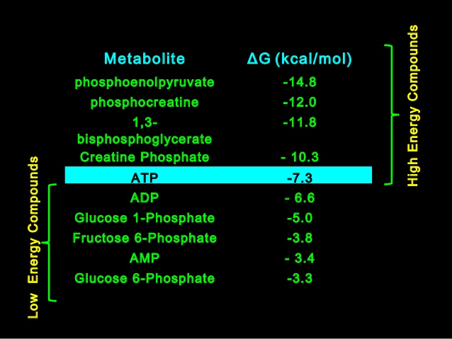

Slide 13
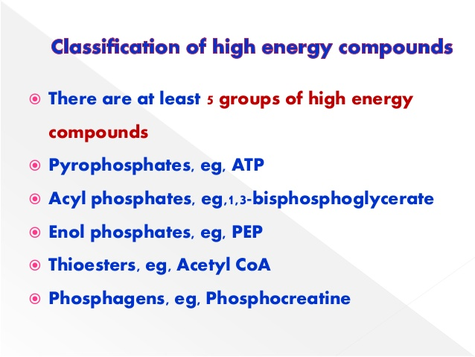
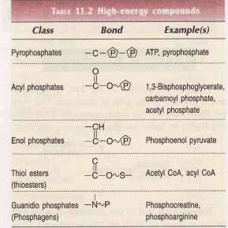

Slide 14
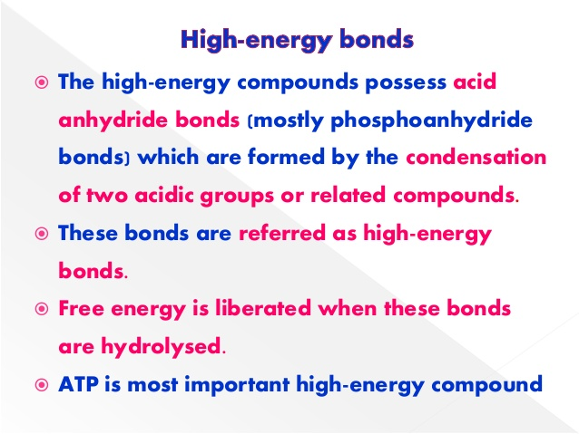

Slide 15
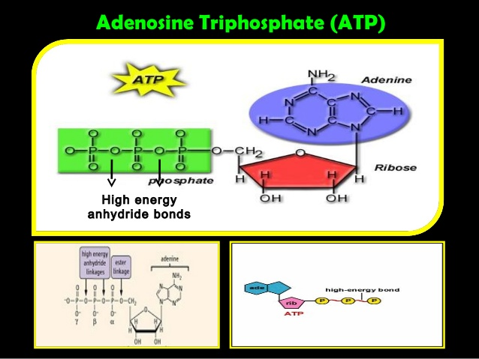

Slide 16
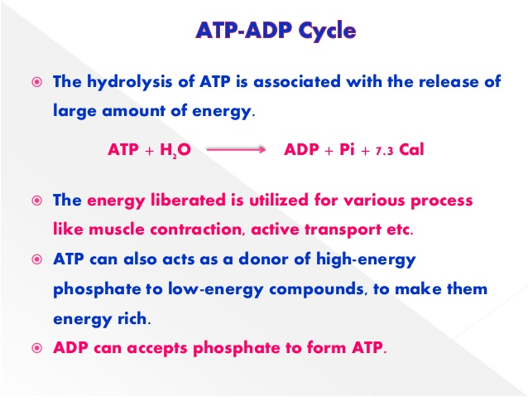

Slide 17
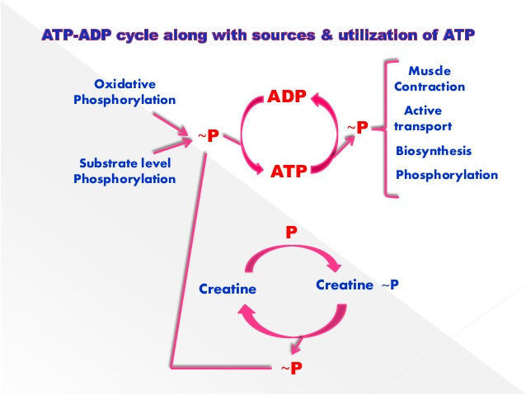

Slide 18
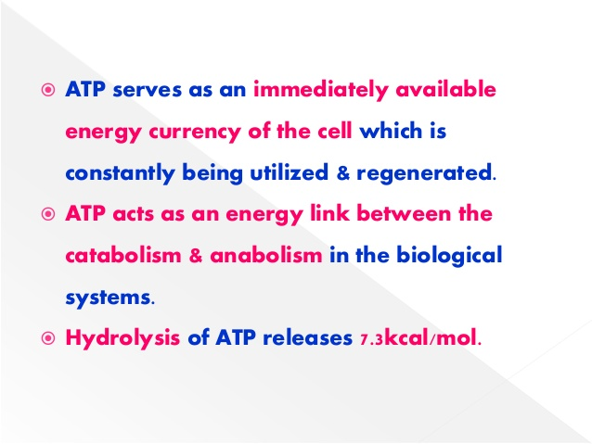

Slide 19
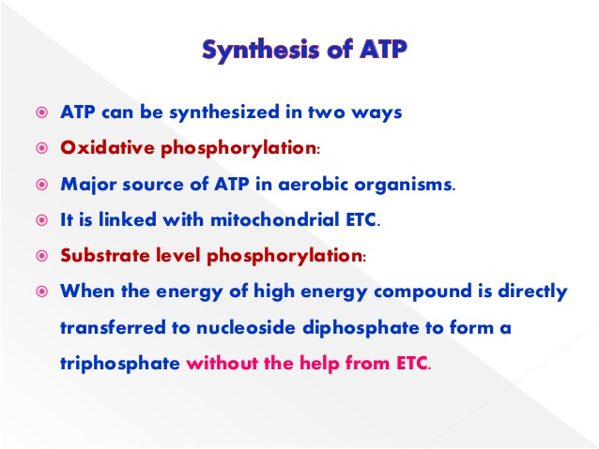

Slide 20
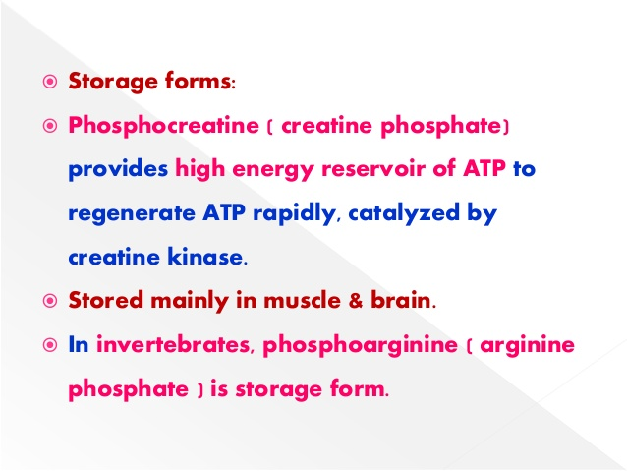

Slide 21
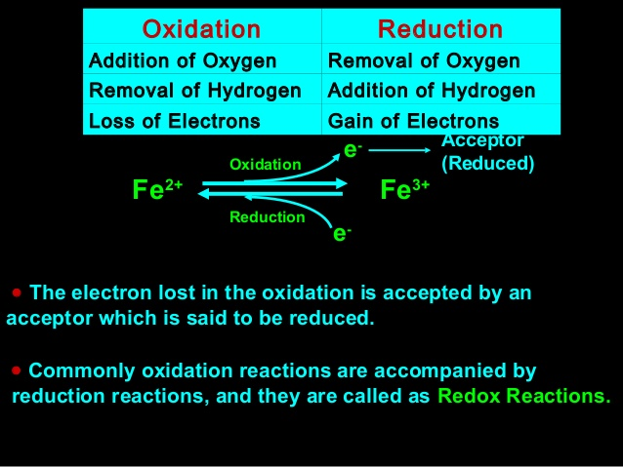
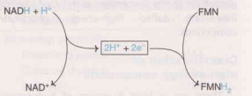

Slide 22
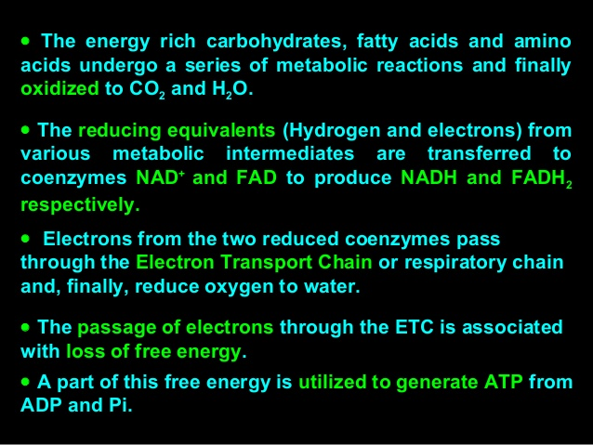
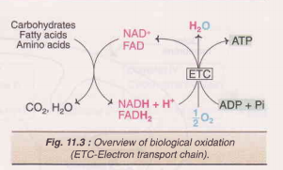

Slide 23
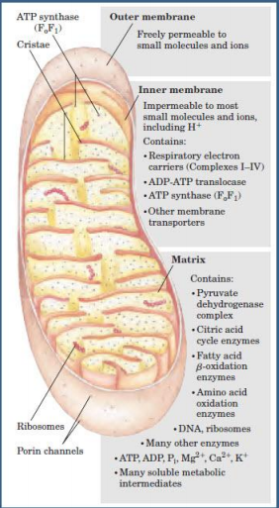
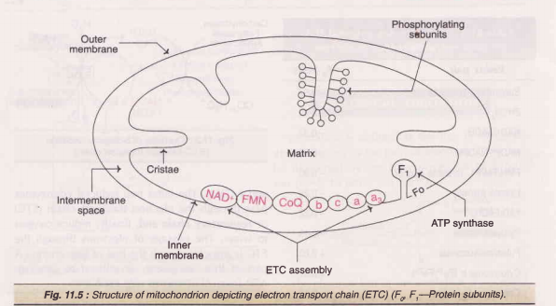
Electron Transport chain/ Respiratory chain

Slide 24
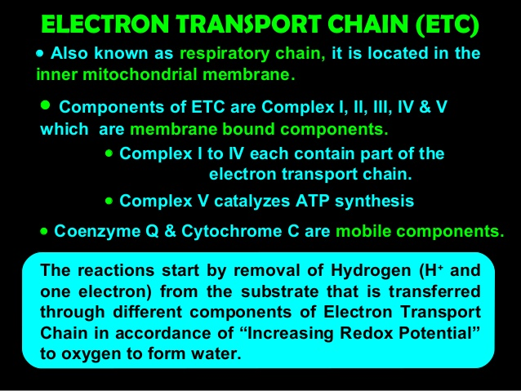

Slide 25
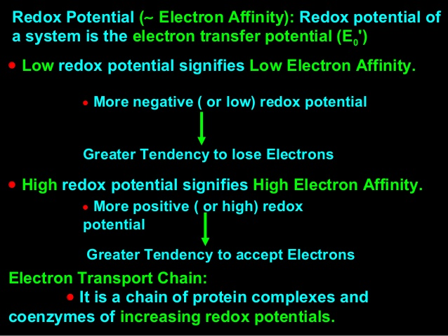

Slide 26
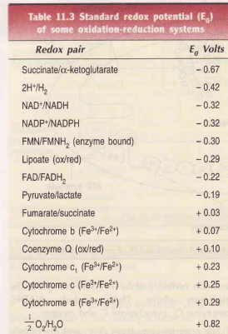
‘Electrons flow through Electron Transport chain in steps from the more electronegative component ( low redox potential ) to the more electropositive component (high redox potential)’
standard redox potential (E₀ volts) at pH 7.0 and 25ºC

Slide 27
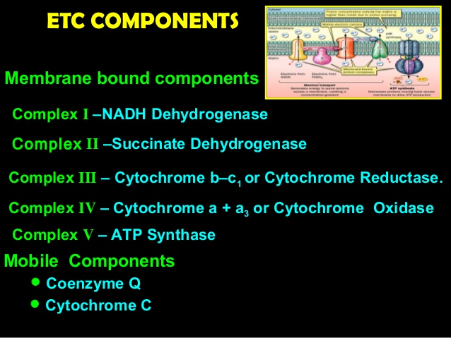

Slide 28
Cytochromes
Cytochrome is a class of haemoprotein (an iron(Fe)-containing haem group attached to protein).
These “cell pigments” are present in all living tissues that require oxygen.
They are involved in the transfer of electrons in association with a reversible change in oxidation state of the haem protein (ferrous (Fe2+) to Ferric (Fe3+).
There are 4 major classes of cytochromes, viz., a, b, c and d.
The members of each subclass are distinguished from each other through numerical subscripts and by their characteristic wavelength of absorption maximum. E.g. Cytochrome C1, Cytochrome C555.
They also differ from each other through their type of haem group.

Slide 29
Flavoproteins
The enzyme “dehydrogenase”, which removes electrons from NADH, or from substrates like succinate, contains flavins as prosthetic group. Flavins are refered to riboflavin (Vitamin -B2).
There are 2 enzyme complexes,
NADH – dehydrogenase, contain FMN (Flavin mononucleotide),
Succinate dehydrogenase, containing, FAD (Flavin adenine dinucleotide)
Fe –S protein
These proteins contain Fe atoms that are bound to the S-atom of the cysteine residues of the protein.

Slide 30
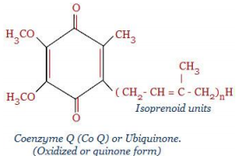
Co-enzyme Q
Co- enzyme Q is a quinone derivative with a long 10 isoprenoid side chain.
It is also called as “Ubiquinone”, because, it is present ubiquitously (ubiquitous = present everywhere) in all biological systems.
It is a lipid soluble compound(lipophilic electron carrier) and therefore freely diffusible within the inner membrane. It is capable of undergoing reversible redox reactions.
it is directly synthesized in the body.

Slide 31
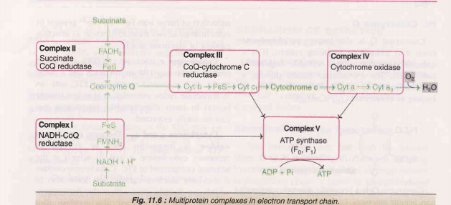
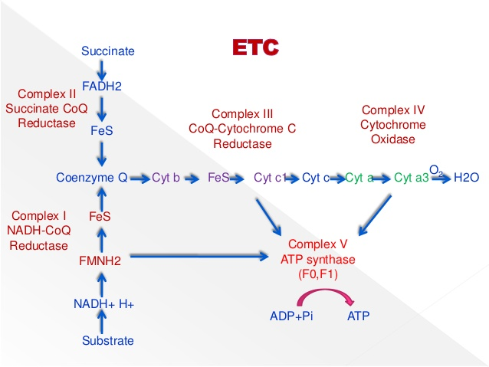

Slide 32
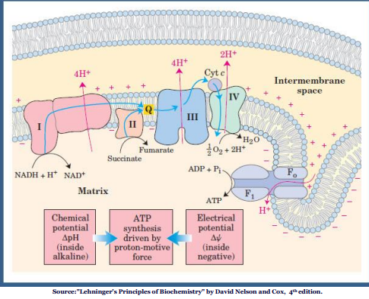
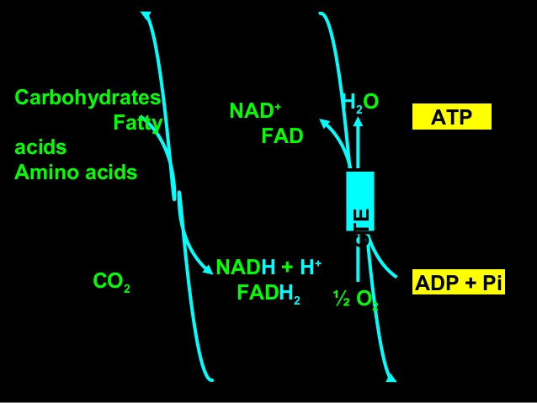

Slide 33
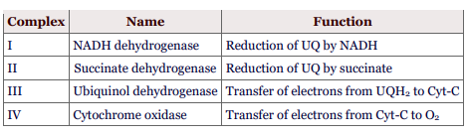
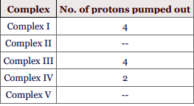
Cytochrome oxidase the only electron carrier, the heme iron of which can directly react with molecular oxygen.Besides heme (with iron), this oxidase also contains copper that undergoes oxidation reduction (Cu2+ to Cu+) during the transport of electrons

Slide 34
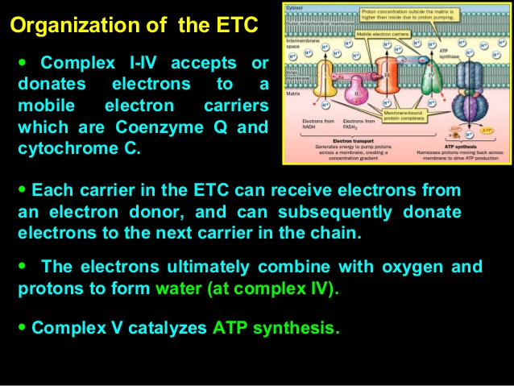

Slide 35
oxidative phosphorylation (complex V)
The process of synthesizing ATP from ADP and P_{i} coupled with the electron transport chain is known as oxidative phosphorylation
P/O ratio or P:O
The number of molecules of ATP formed per pair of electrons transferred down the respiratory chain to atomic oxygen is termed P/O ratio.
1. When substrates are oxidized via NAD-linked dehydrogenase( complex I) in the respiratory chain, P/O ratio is = 2.5
( 10 proton)
4 proton = 1 ATP
10/4= 2.5 ATP= NADH
2. When a substrate like succinate is oxidized via a flavoprotein – linked dehydrogenase(complex II). P/O =1.5
( 6 proton)
4 proton = 1 ATP
6/4= 1.5 ATP = FADH2
(1.5 ATP)

Slide 36
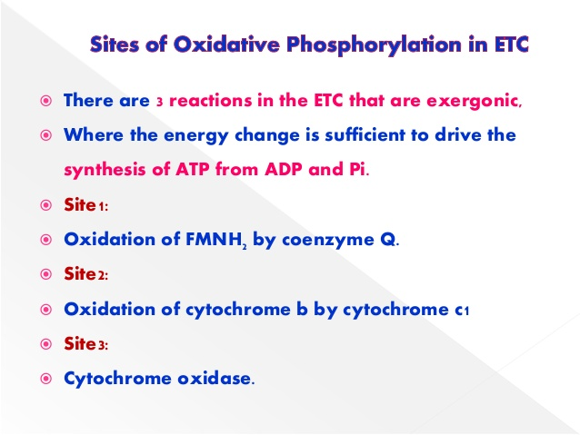
Energetics of oxidative phosphorylation
when NADH is oxidized, 35% of energy is trapped in the form of 2.5 ATP & remaining is lost as heat

Slide 37
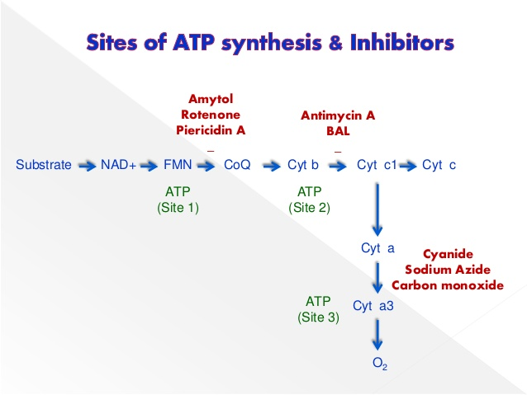

Slide 38
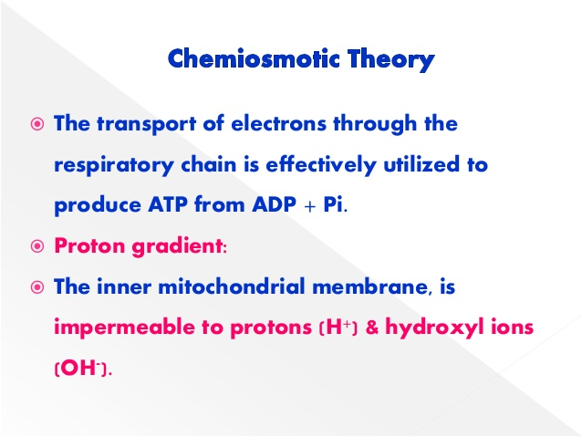
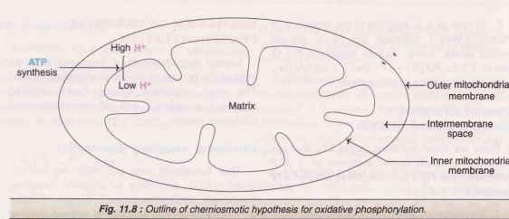
Mechanism of oxidative phosphorylation
1.
Peter mitchell 1961

Slide 39
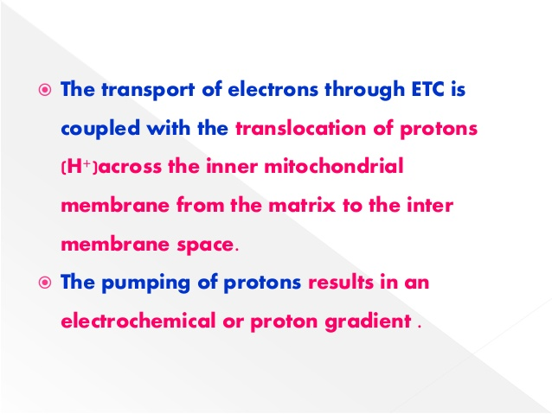
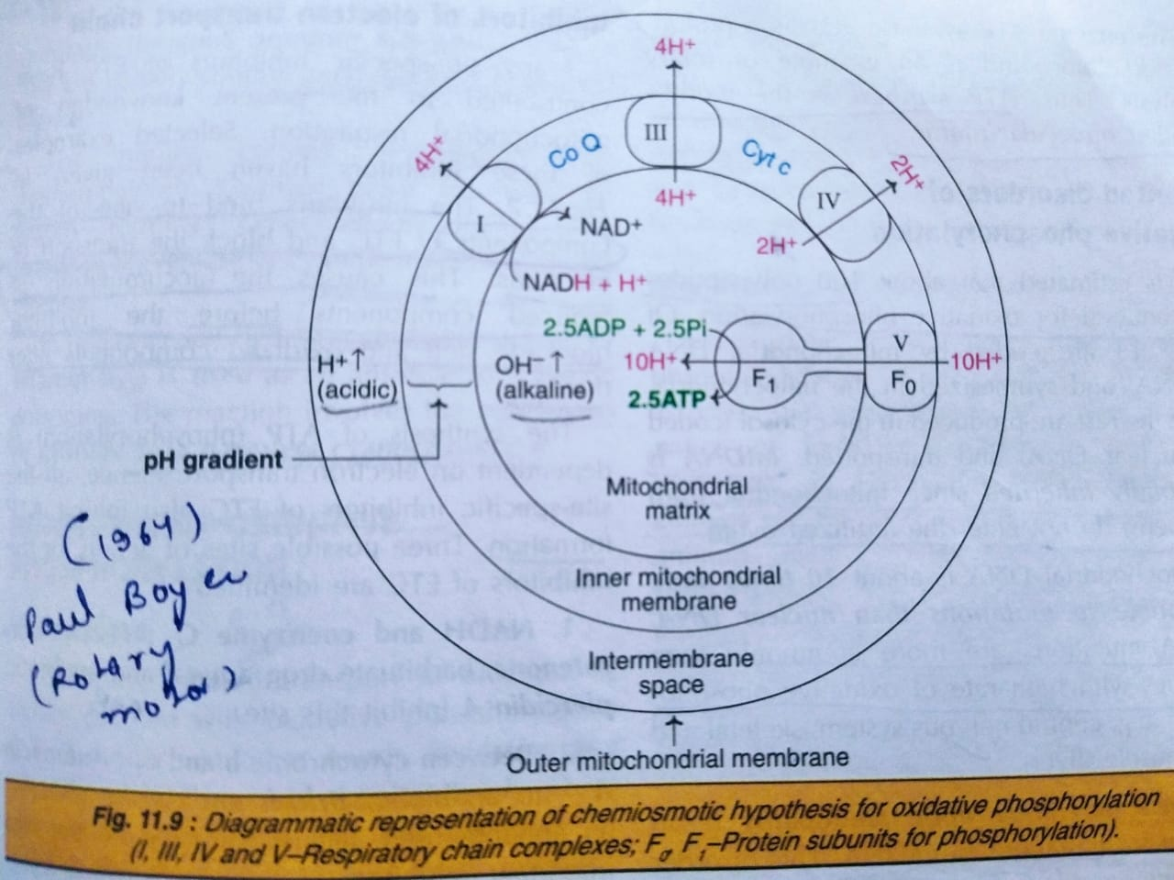
4H⁺
4H⁺

Slide 40
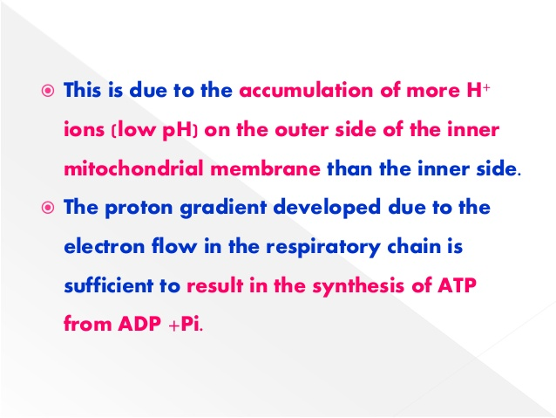

Slide 41
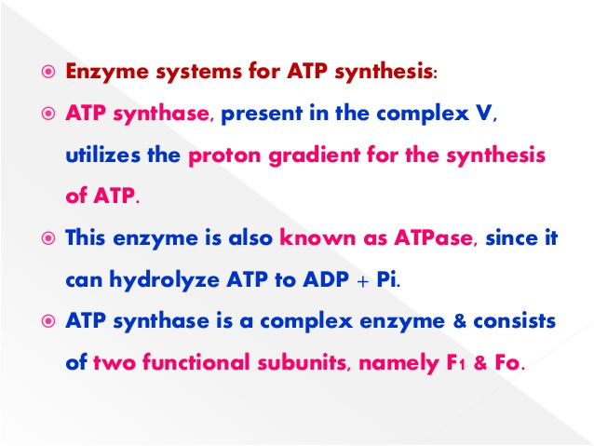
2

Slide 42
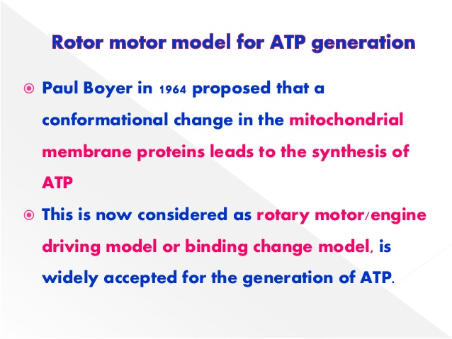

Slide 43
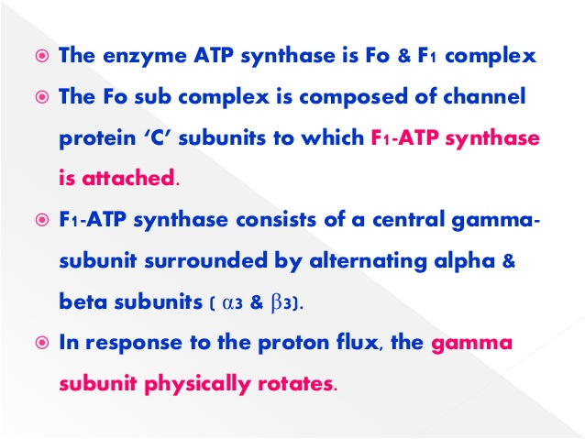
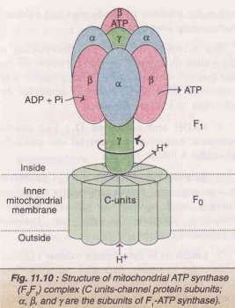

Slide 44
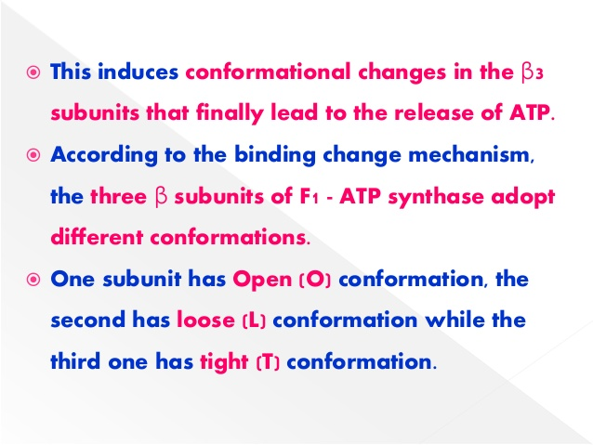
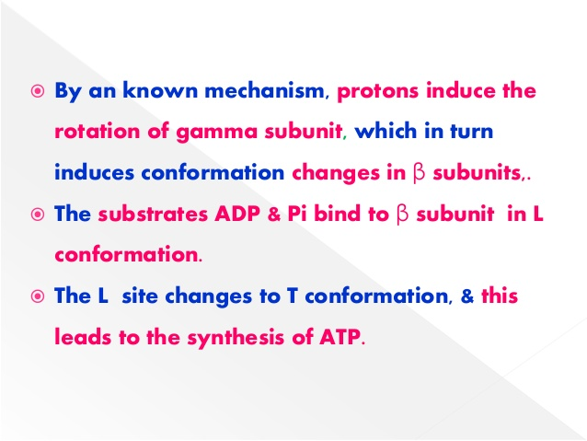

Slide 45
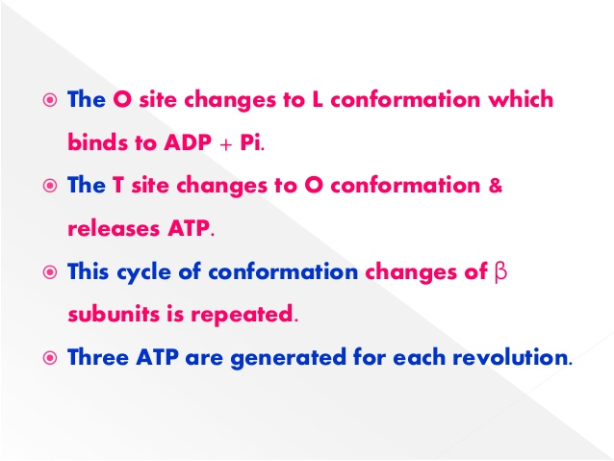
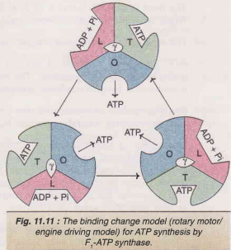
2.5 ATP

Slide 46



Slide 47


Slide 48


Slide 49
Shuttle pathways-transport of reducing equivalents
The inner mitochondrial membrane is impermeable to NADH. Therefore, the NADH produced in the cytosol cannot directly enter the mitochondria
Two main shuttle systems are of importance
Glycerol phosphate shuttle – present in skeletal muscle and brain
Malate shuttle – present in liver, kidney and heart mitochondria

Slide 50

Glycerol phosphate shuttle
1.5
FADH₂ gets oxidized via ETC to generate 1.5 ATP.

Slide 51

Malate aspartate shuttle
2.5
NADH gets oxidized via electron transport chain and 2.5 ATP are produced

Slide 52


Slide 53


Slide 54


Slide 55


Slide 56

Monooxygenases also known as hydroxylases, mixed function oxidases, mixed function oxygenases
Examples: microsomal cytochrome P-450 monooxygenase

Slide 57


